Slide 1
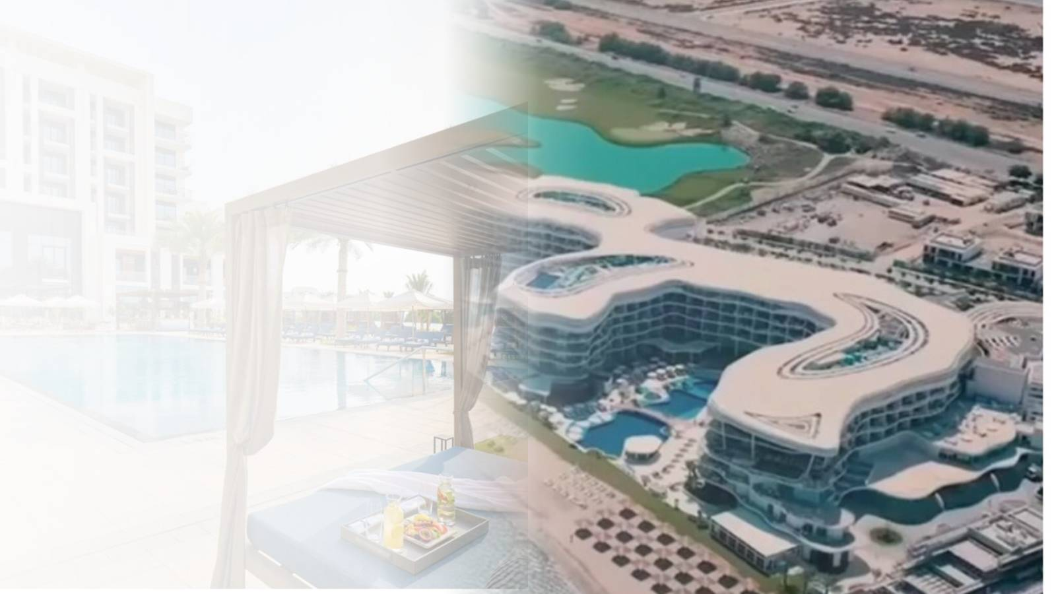

MAHD AL MUSTAQBAL
MMT Cleaning Services
COMPANY PROFILE · 2026
Cleaner spaces.
Healthier lives.
Oman's trusted partner for professional residential, commercial and facade cleaning — since 2006.
TRUSTED BY The St. Regis Al Mouj · Mandarin Oriental Muscat ★★★★★
Since 2006
Muscat · Duqm · Salalah
www.mmt-om.com

Slide 2
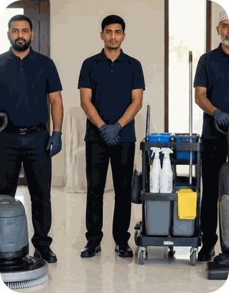
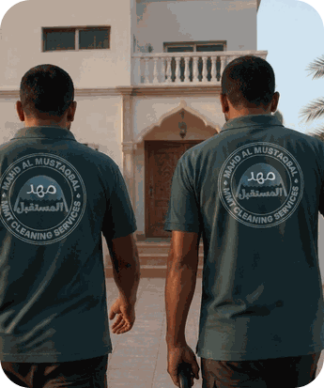
INSIDE THIS PROFILE
Contents
01
Leadership messages
p. 03
02
Who we are
p. 05
A complete look at who we are, what we do and the clients who trust us across Oman.
03
Our services
p. 09
04
How we deliver
p. 16
05
Our clients
p. 20
06
Gallery & contact
p. 25

Slide 3
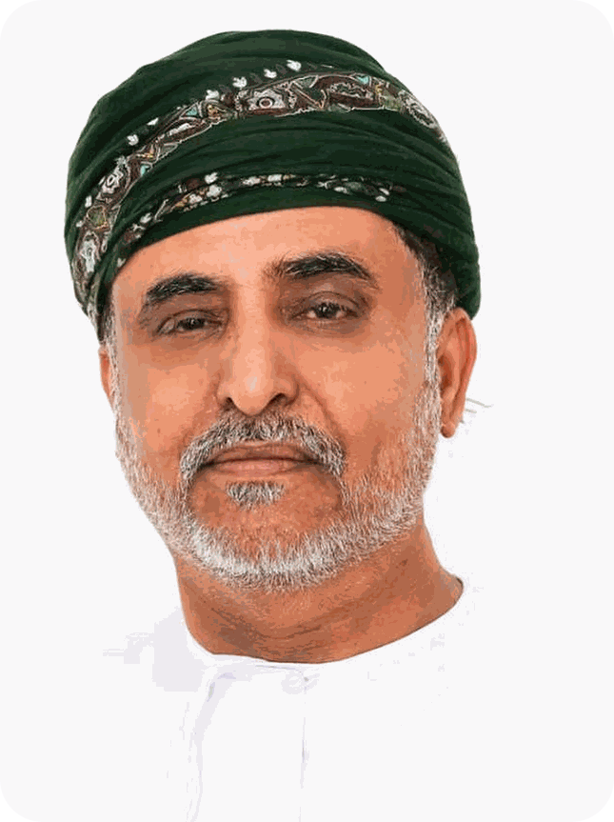

CHAIRMAN'S MESSAGE
Excellence starts with cleanliness
At MMT Cleaning Services, we believe true excellence starts with cleanliness. Our mission is to create safer, healthier and more welcoming spaces for people to live and work in. From homes to large corporate facilities, every project reflects our dedication to quality, professionalism and trust.
Over the years we have built more than a service — we have built relationships based on reliability, transparency and care, and our team works tirelessly so every client experiences the highest standards of hygiene.
As we continue to serve Muscat, Salalah and beyond, our goal is to remain Oman's most trusted cleaning partner — committed to innovation, sustainability and customer satisfaction at every step.
Said Bakhit Hassan Al Amri
Chairman

Slide 4
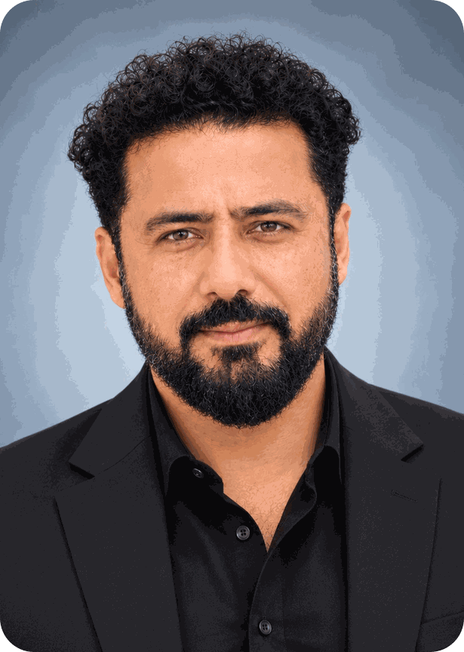



MESSAGE FROM OPERATIONS
Efficiency, quality and professionalism in every visit
As Operations Manager, my commitment is to ensure that every service delivered by MMT reflects efficiency, quality and professionalism, so we continue to meet our clients' expectations and uphold our reputation as one of Oman's most dependable cleaning providers.
We proudly serve leading companies in aviation, retail, hospitality, real estate and corporate sectors across Muscat and Salalah. Their trust drives us to refine our procedures and deliver long-term value.
Zubair Al Baloushi
Operations Manager
A plan for every site
A checklist for every crew
A walkthrough for every job

Slide 5
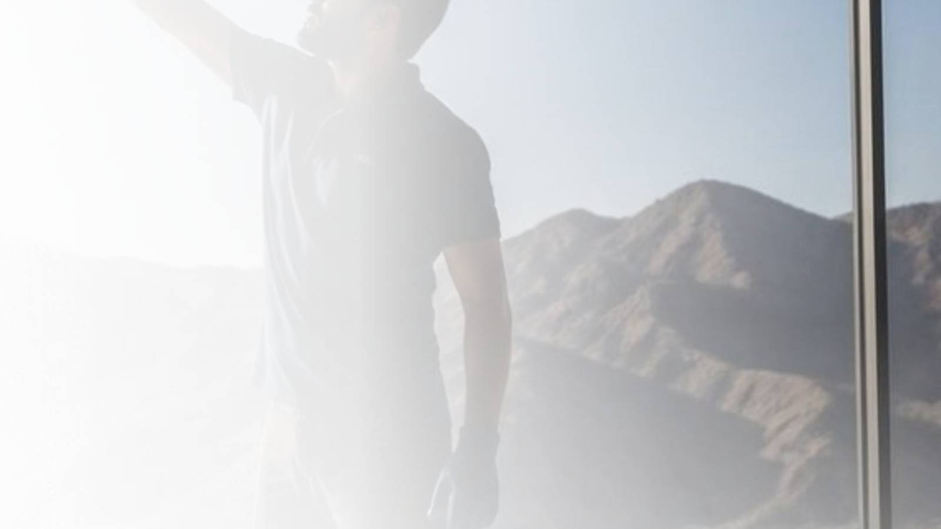
01
Who we are
Nearly two decades of planned, supervised and accountable cleaning across Oman.

Slide 6
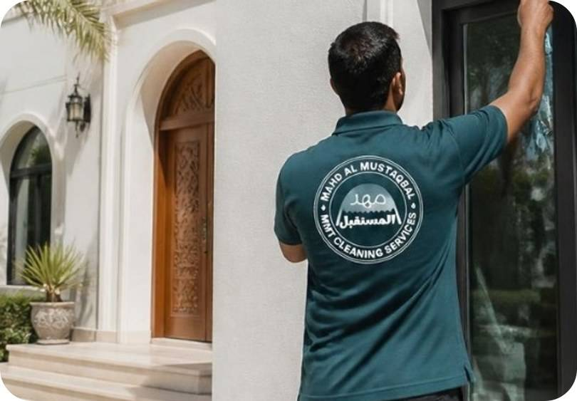
ABOUT US
Oman's cleaning partner since 2006
Mahd Al Mustaqbal – MMT Cleaning Services is a leading provider of professional cleaning in Muscat and across Oman, delivering complete solutions for residential, commercial and industrial spaces.
What began as a small team in Salalah is now a trusted name for villas, offices, retail, hospitality and corporate facilities. We plan every job, supervise our crews and stay accountable for the result.
2006
3
15
IRATA
Established in Salalah
Cities: Muscat, Duqm, Salalah
Specialised services
Certified rope access team

Slide 7






OUR JOURNEY
A journey of excellence since 2006
2006
2014
2022
The beginning
Specialised services
Leading businesses
MMT Cleaning Services is founded in Salalah.
Deep cleaning and pest control launched for homes and businesses.
Partnerships with SalamAir, Redtag, Prime Business Solutions and Azadea Group.
2010
2018
2024
Expanding our reach
Eco-friendly shift
Nationwide reach
Operations expand to Muscat for corporate and commercial clients.
Environmentally safe products and sustainable practices adopted.
Full-scale operations with greater capacity and modern technology.

Slide 8






WHAT DRIVES US
Vision, mission & values
Our vision
Our values
To be Oman's most trusted and innovative cleaning service provider, ensuring healthier and cleaner spaces for every home and business.
Integrity & transparency
Commitment to excellence
Our mission
Respect for clients & employees
To deliver top-quality, eco-friendly and affordable cleaning through highly trained staff, advanced equipment and customised solutions for every client.
Sustainability & eco-responsibility

Slide 9
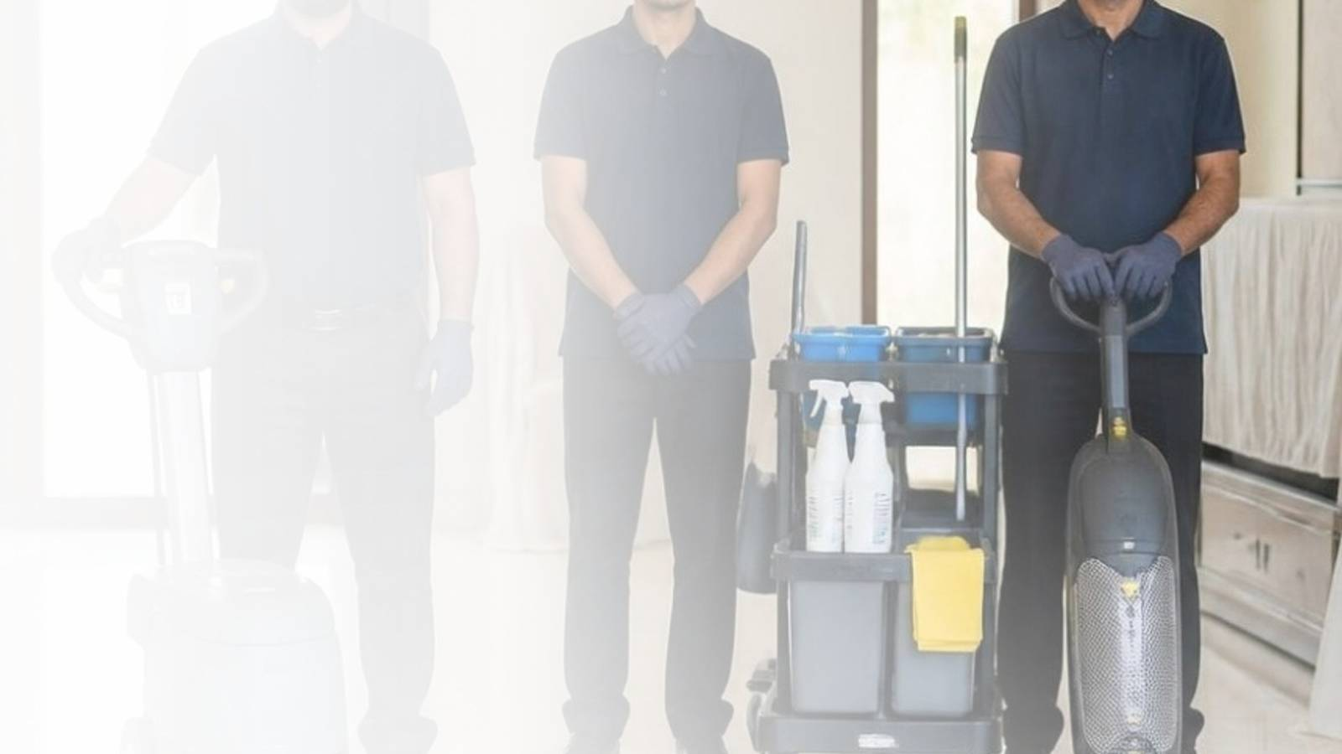
02
Our services
Complete cleaning solutions for homes, offices, facilities and high-rise buildings.

Slide 10















WHAT WE OFFER
15 services, one trusted team
House & villa cleaning
Deep cleaning
Office cleaning
Daily & contract cleaning
Move-in / move-out
Kitchen cleaning
Carpet & rug cleaning
Sofa & upholstery
Window cleaning
Facade & rope access
Warehouse & industrial
Post-construction
Pest control
High-level cleaning
Sanitisation & disinfection

Slide 11
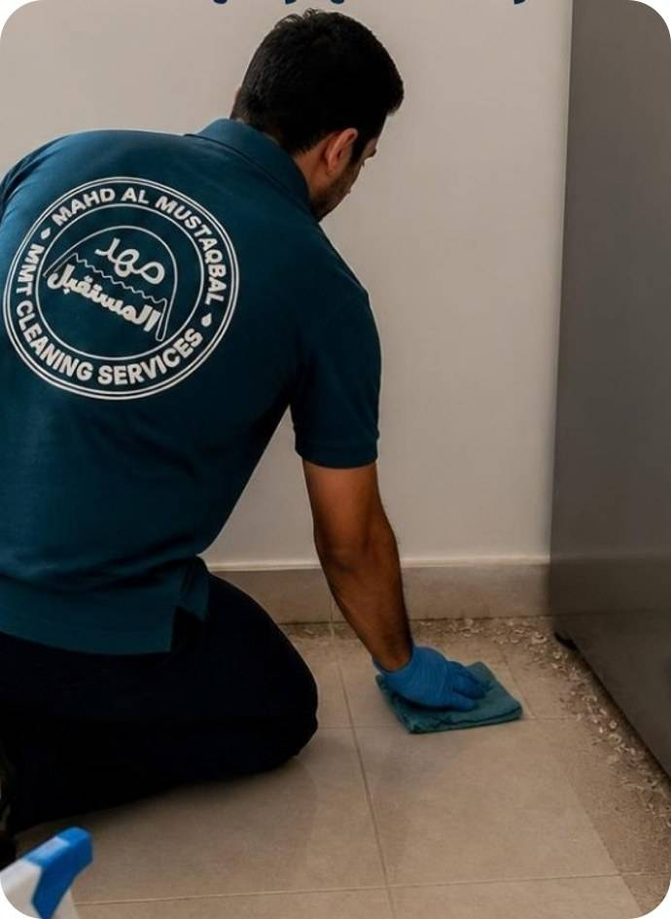





RESIDENTIAL CLEANING
Spotless homes, villas & apartments
House cleaning
Daily or scheduled visits covering every room.
Kitchen cleaning
Removal of grease, stains and bacteria.
Carpet & sofa cleaning
Fresh, stain-free and sanitised fabrics.
Deep cleaning
Move-ins, post-renovation and seasonal resets.
Move-in / move-out
Handover-ready cleaning of empty homes.
Homes & villas
across Muscat
FLEXIBLE SCHEDULES
One-time
Weekly
Bi-weekly
Monthly

Slide 12
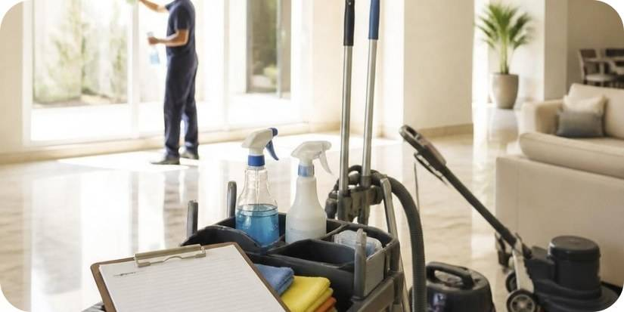





COMMERCIAL & OFFICE
Clean, professional workplaces
Daily, periodic and contract cleaning for offices, retail, warehouses and commercial buildings — scoped to your site and scheduled around your operations.
WHO WE SERVE
Office cleaning
Shop & store cleaning
Offices
Retail stores
Floors, desks, pantries & washrooms.
Retail outlets kept attractive & hygienic.
Warehouses
Commercial buildings
Warehouse cleaning
Contract cleaning
Property managers
Hotels & facilities
Large-scale cleaning, pro equipment.
Daily, weekly or monthly programmes.

Slide 13
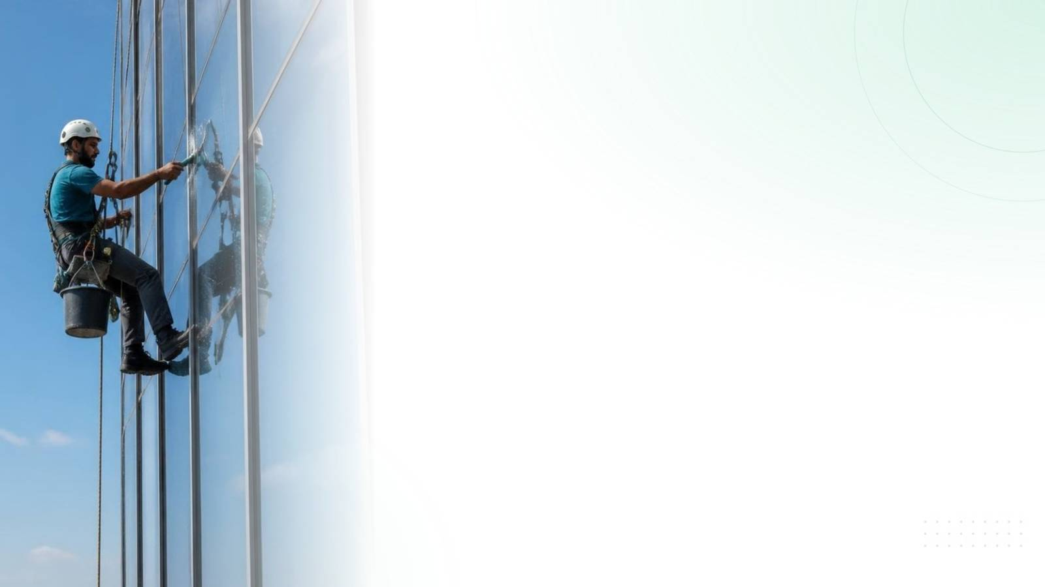






SPECIALISED SERVICES
Expertise for demanding jobs
Facade & window
Spotless exteriors and streak-free glass.
Pest control
Safe, eco-friendly protection against pests.
Industrial cleaning
Heavy-duty cleaning for factories & warehouses.
Sanitisation
Disinfection for safe, germ-free spaces.
Post-construction
Dust, paint and debris removal after works.
High-level cleaning
Ceilings, lights and hard-to-reach areas.

Slide 14
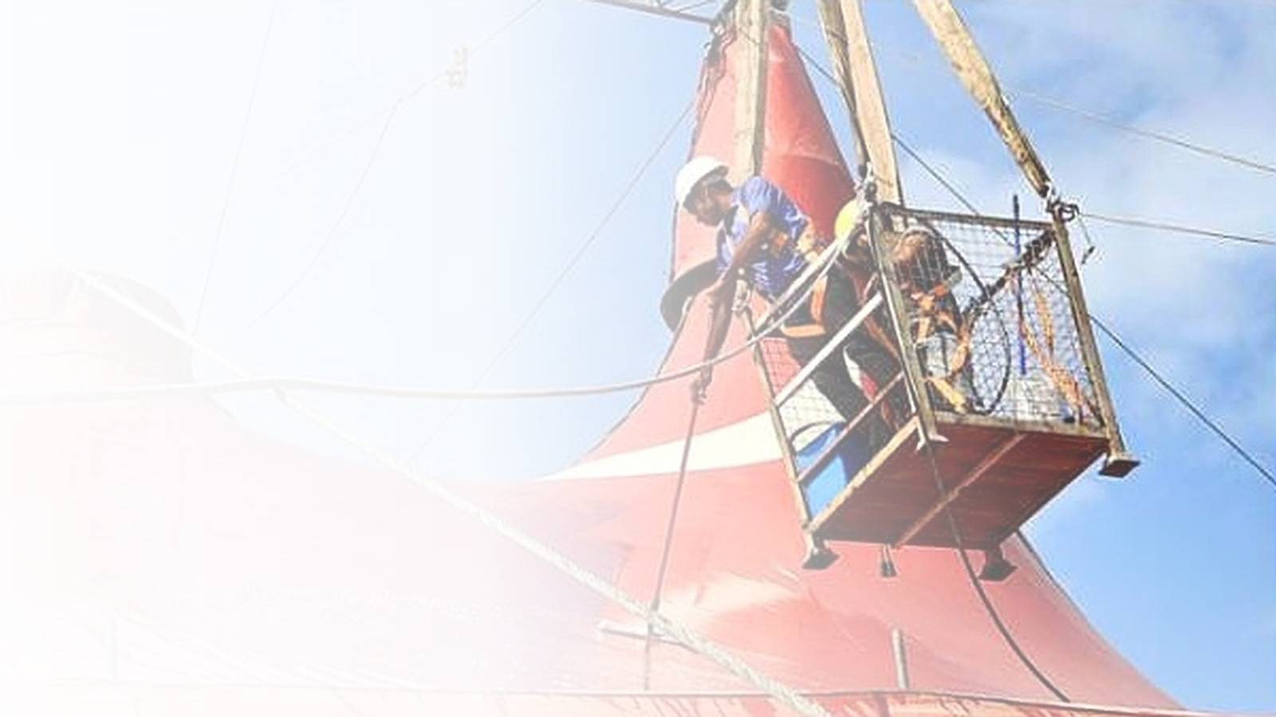
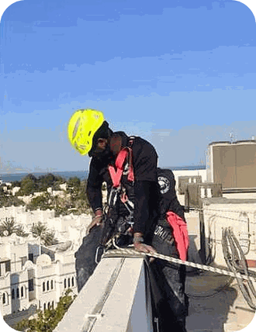
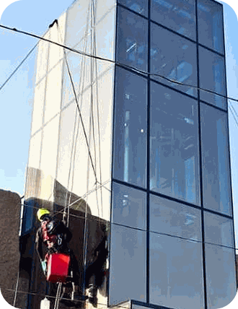

FACADE & ROPE ACCESS
IRATA-certified facade cleaning
Humidity, coastal salt and dust mean Oman's buildings need professional care. Rope access lets our team reach difficult areas with precision and minimal disruption — the safest, most cost-effective method for high-rise cleaning.
What we do
Why MMT
High-rise glass & window cleaning
Cladding & ACP panel cleaning
High-pressure exterior washing
Post-construction facade restoration
IRATA-certified rope access team
Risk-controlled, high-safety work
Expertise in Oman's climate
Advanced tools, eco-friendly products

Slide 15
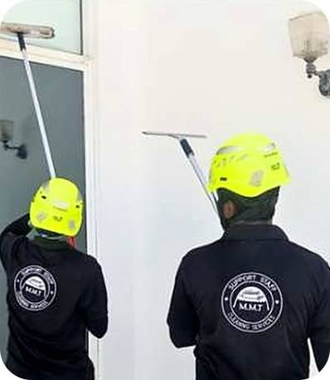
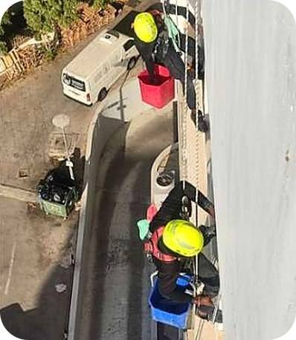

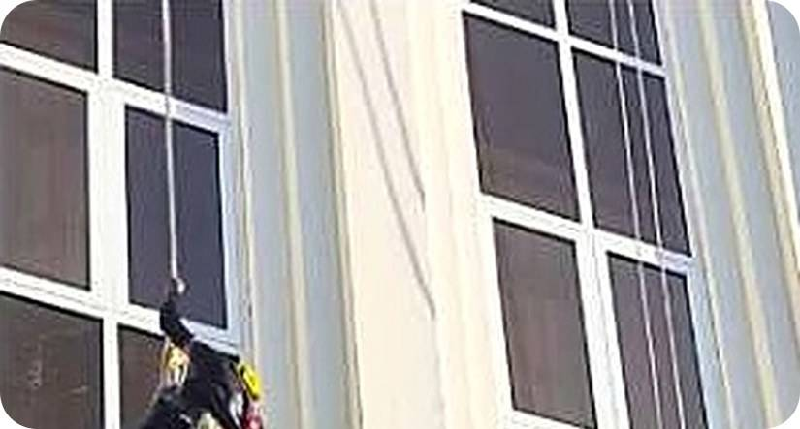
FACADE PROJECTS
Completed & active projects
Completed facade projects and multiple active contracts across Muscat — scheduled and contract-based.
Hat Entertainment – Active Oman
Ufaq Business Center, Qurum
Mirani Fort
Business Tower, Muscat Hills
Ominvest Building
Towell Properties

Slide 16
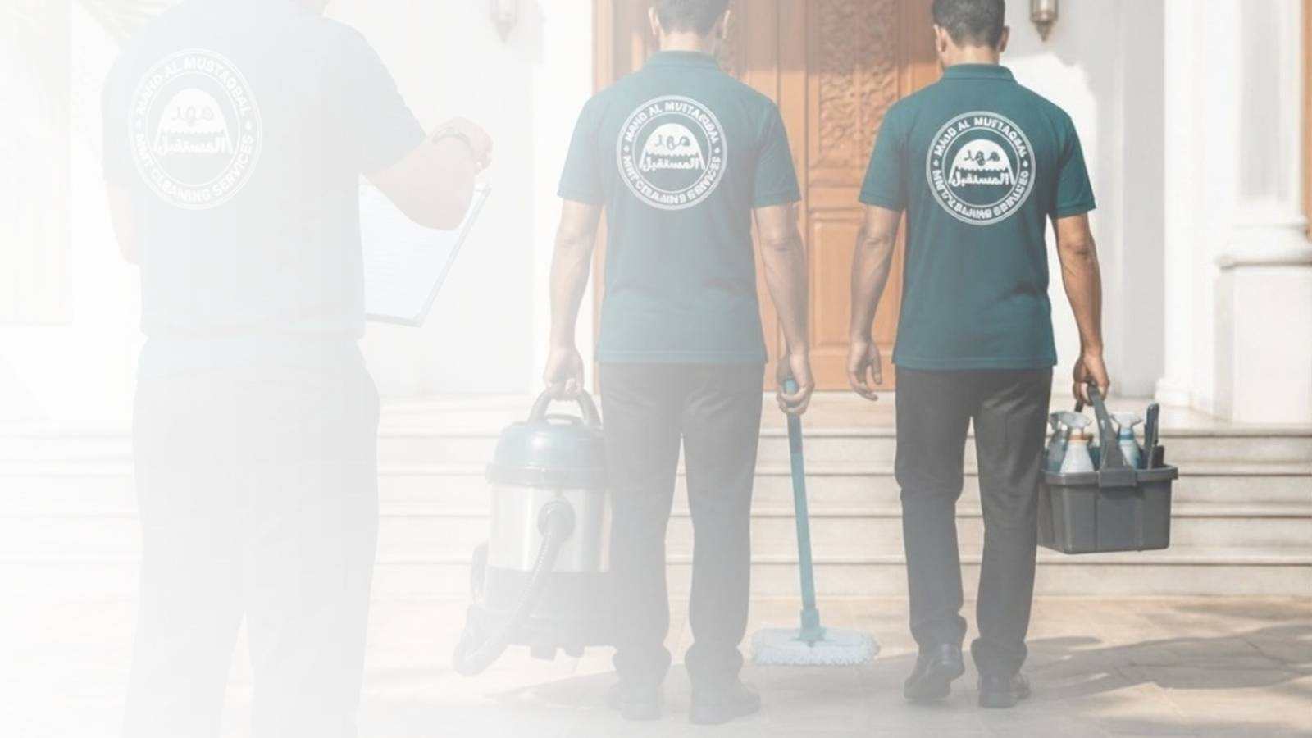
03
How we deliver
Clear scopes, trained crews and a result you check before we leave.

Slide 17




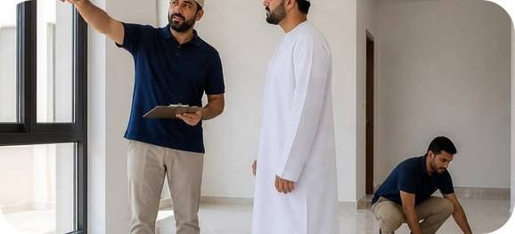
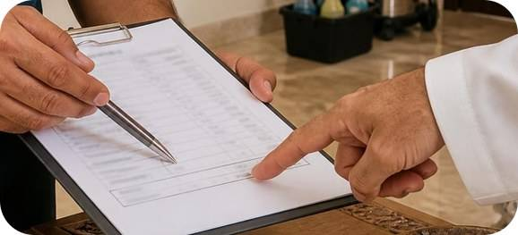
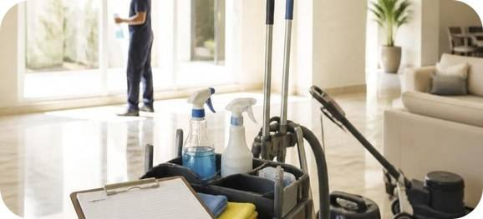
HOW WE WORK
From enquiry to ongoing service
01
02
03
04
05
Enquiry
Site assessment
Proposal
Mobilise
Quality check
Tell us about your property by phone, WhatsApp or online.
We review areas, surfaces and priorities.
Clear scope, schedule and transparent pricing.
An equipped crew briefed on your site.
Final walkthrough and ongoing checks.

Slide 18
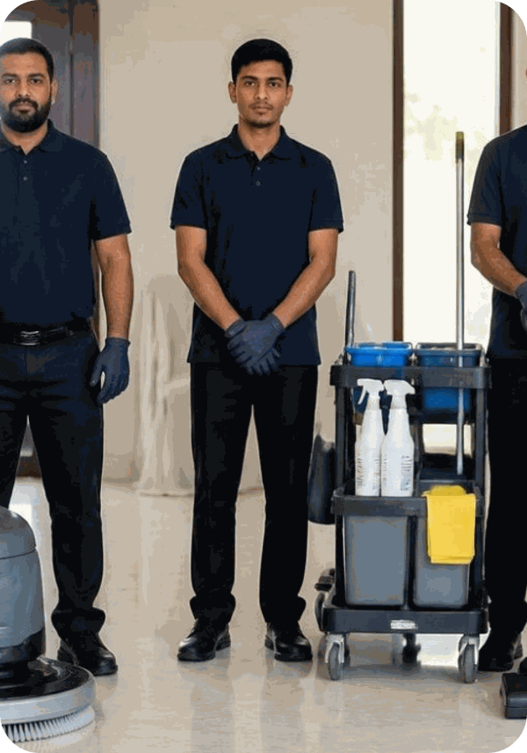






WHY CHOOSE MMT
Built on trust & quality
Trained, uniformed staff
Vetted crews who respect your space.
Eco-friendly products
Safe for families, pets & surfaces.
Transparent pricing
Clear written scope, no surprises.
Flexible schedules
Daily, weekly, monthly or one-time.
Advanced equipment
Professional machines for every surface.
One point of contact
Direct line by phone or WhatsApp.
Our uniformed MMT team

Slide 19
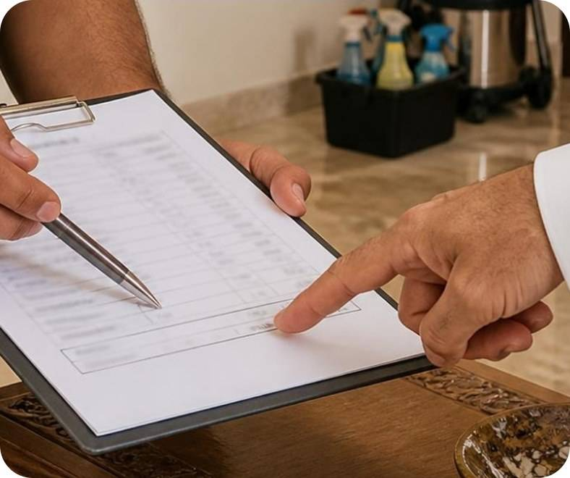



QUALITY & SAFETY
Standards on every job
Agreed checklists
Supervised crews
Scope in writing, so standards stay consistent every visit.
Every team works to a checklist under a supervisor.
Safe practice
Final walkthrough
Correct products & PPE, with care around children and pets.
We check the result with you and fix anything missed.

Slide 20




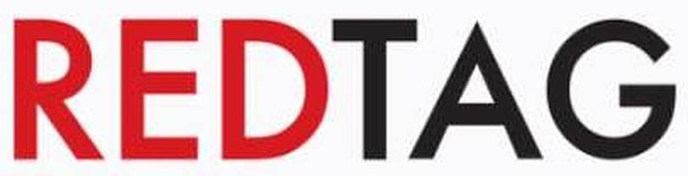
CLIENT APPRECIATION
What our clients say
MMT Cleaning Services has been an exceptional partner for maintaining the hygiene of our offices. Their team is prompt, professional and delivers results beyond expectations.
We value MMT's consistency and flexibility. They truly understand the needs of our business and maintain our properties with the highest standards of care.
Excellent service and well-trained staff. MMT has been our go-to cleaning company for years, and their quality never disappoints.
Facilities Manager
SalamAir – Muscat
Operations Head
Prime Business Solutions – Muscat
Store Manager
Redtag – Oman

Slide 21
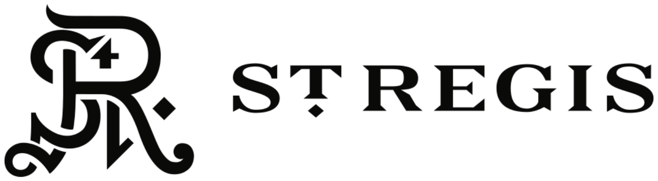

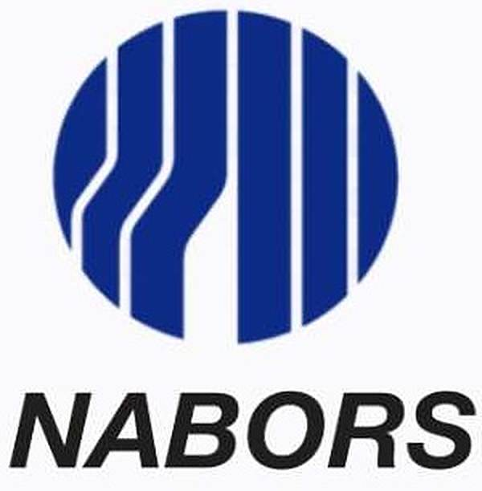




FEATURED CLIENTS
Trusted by five-star hotels & global leaders
5-STAR HOTEL
★★★★★
5-STAR HOTEL
★★★★★
GLOBAL
GLOBAL
Hotel & Residences
Hotel & Residences
Defence & Aerospace
Oil & Gas Drilling
AIRLINE
GLOBAL
GLOBAL
OMAN
Aviation
Digital Consulting
Defence Technology
Diversified Group

Slide 22






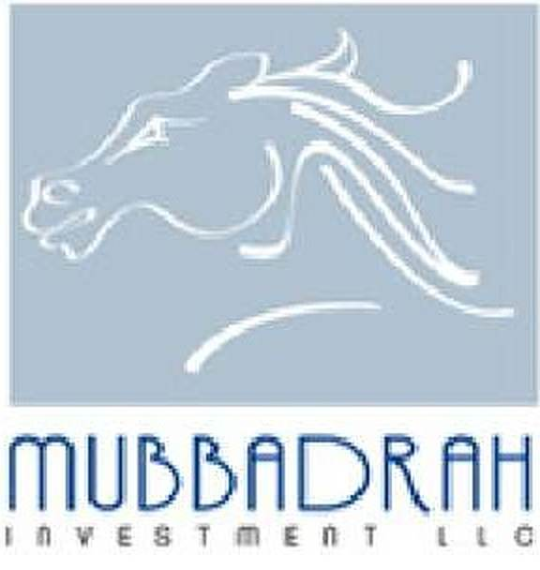


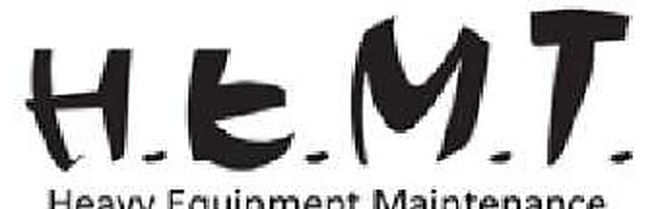









OUR CLIENTS
60+ organisations trust MMT
Byanat
Insight Information Security
Wadi Noor Solar Power
Rezone Properties
Machines Master Middle East
Al Saigh Integrated
Revival Coffee Shop
Money Guard Technology
MNZ Logistics

Slide 23
OUR CLIENTS · CONTINUED
Across every sector in Oman
Gates of Arabia
Experts Service Management
Tariq Al-Busaidi Legal Consultancy
GEO Solution
Decree
PPF Pipes & Valves
Tara Business Investment
Al Sorouh Design & Engineering
Micro Software Solution
Geo Building
Al Shumokh
Hamood Al Musalhi Lawyers
Mangusteen
Al Ghazi International
Ghannam Medical
Elite Project Investments
Cylera Solutions
Al Majal Environment
Spectrum Child Care
Madad
DS Rental
Al Masar Silver for Business
Compass Logistics

Slide 24
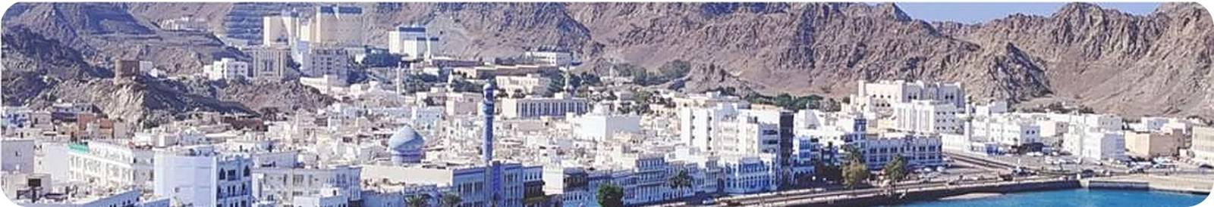

WHERE WE WORK
Serving Muscat, Duqm & Salalah
Muscat
Duqm
Salalah
Head office in Muscat Hills — homes, offices, retail, towers and facade projects.
Post-construction, move-in and commercial cleaning for Oman's industrial hub.
Where MMT began in 2006 — villas, rental turnovers and Khareef-season cleaning.

Slide 25
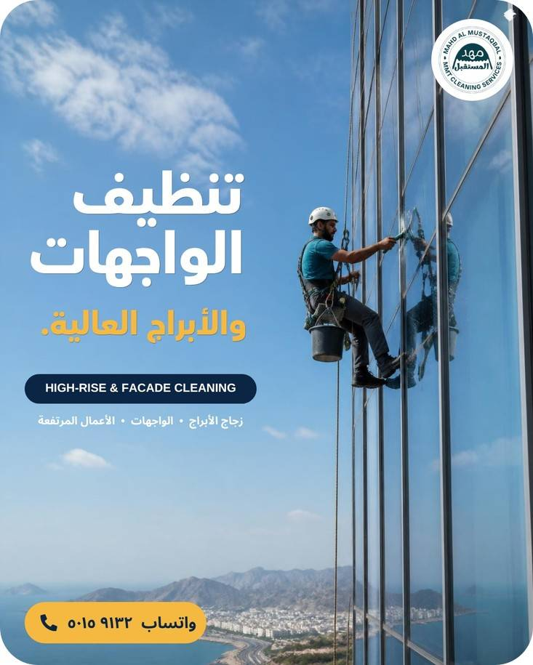
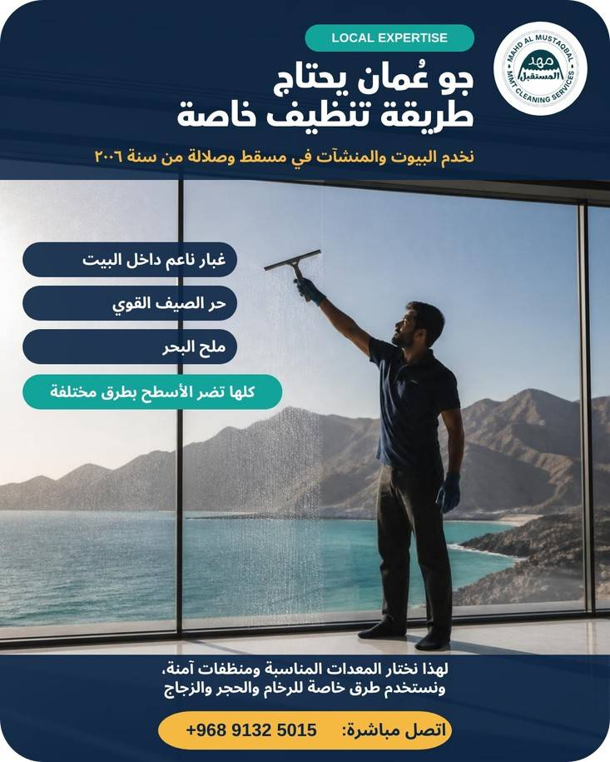
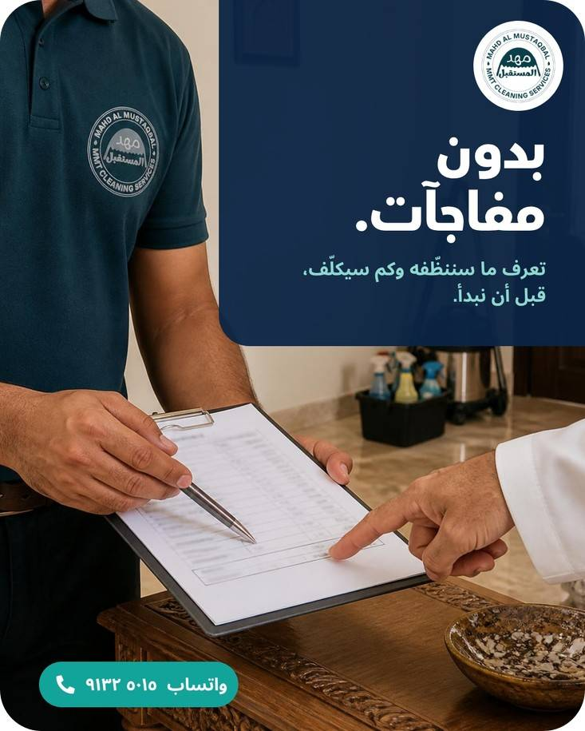
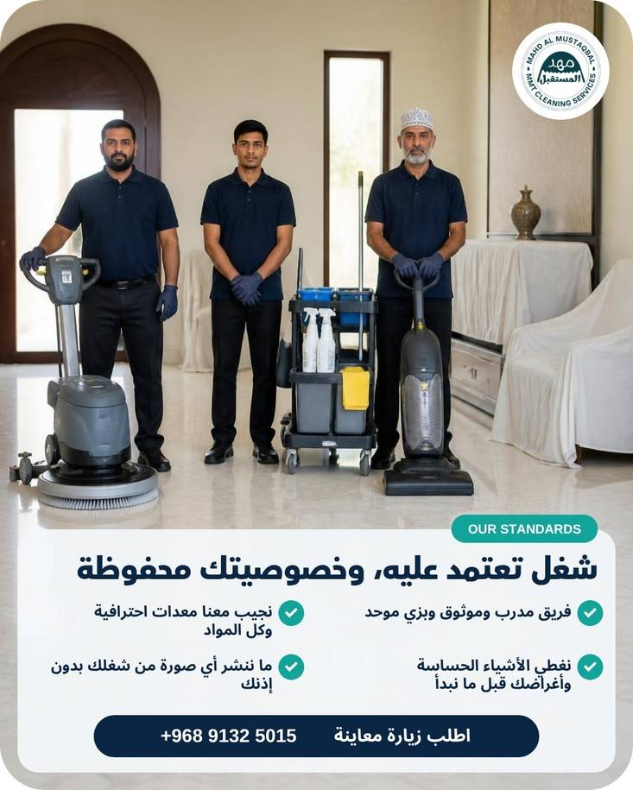
OUR WORK IN ACTION
Project gallery
Notes:
MMT social media posts gallery.

Slide 26
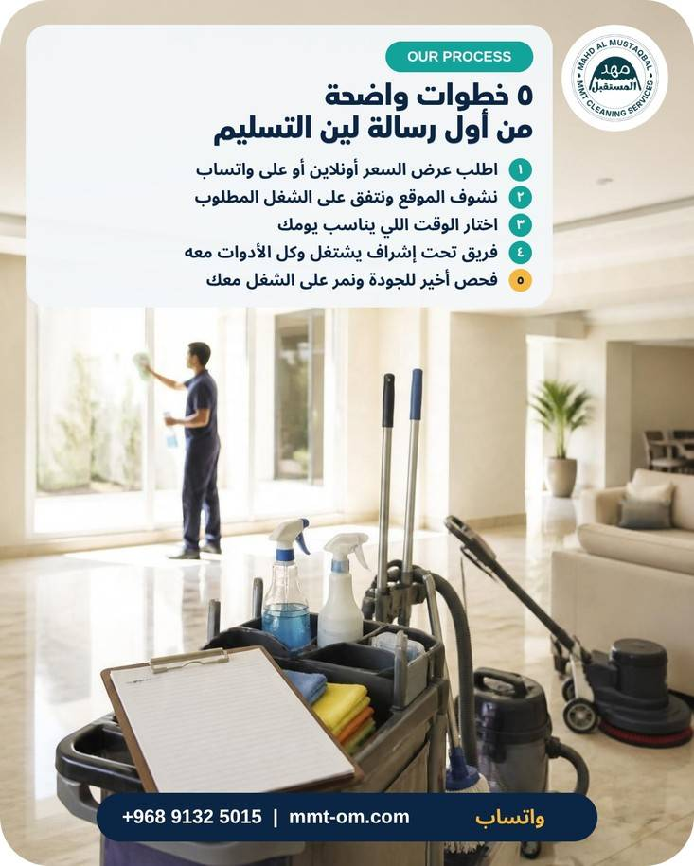
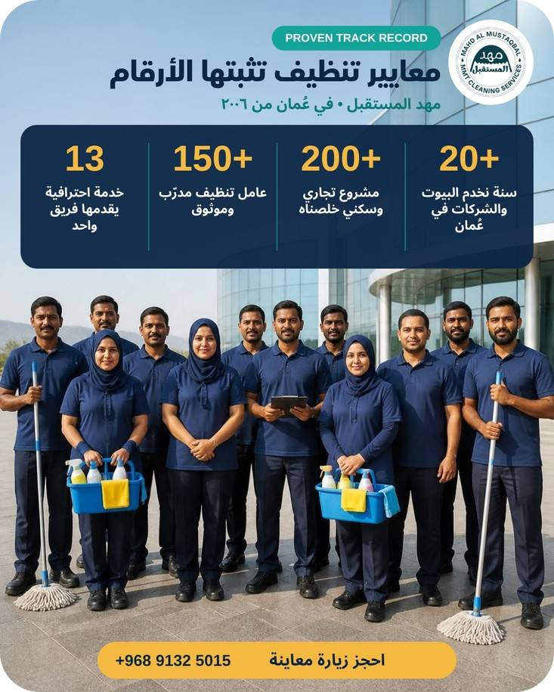
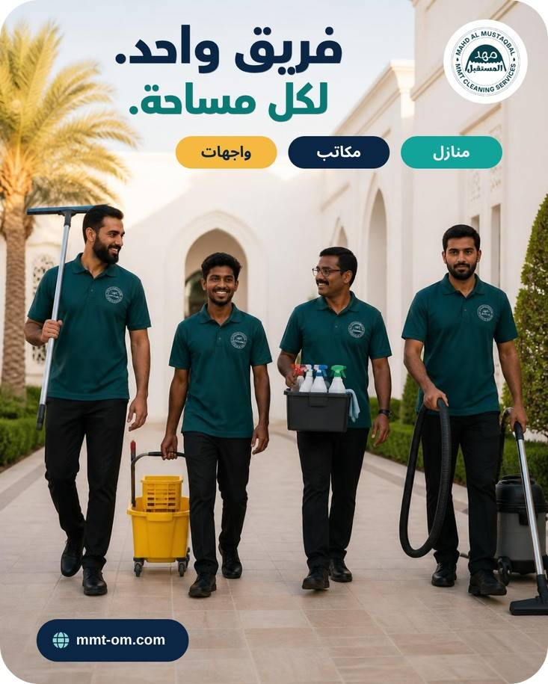
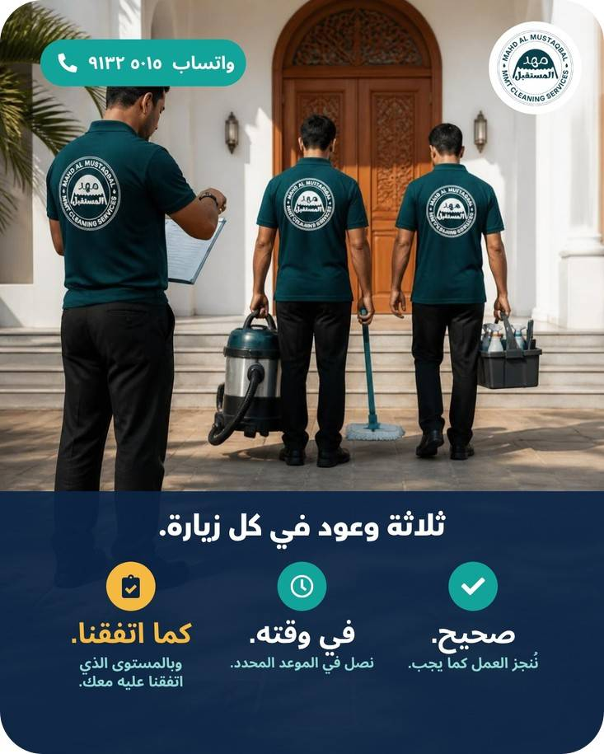
GALLERY · CONTINUED
On site with MMT
Notes:
MMT social media posts gallery.

Slide 27
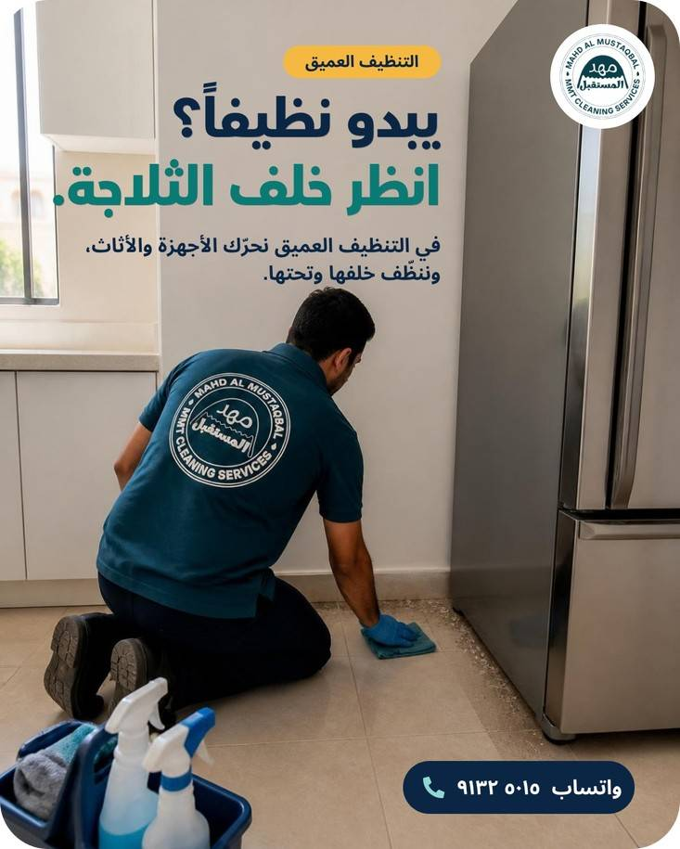
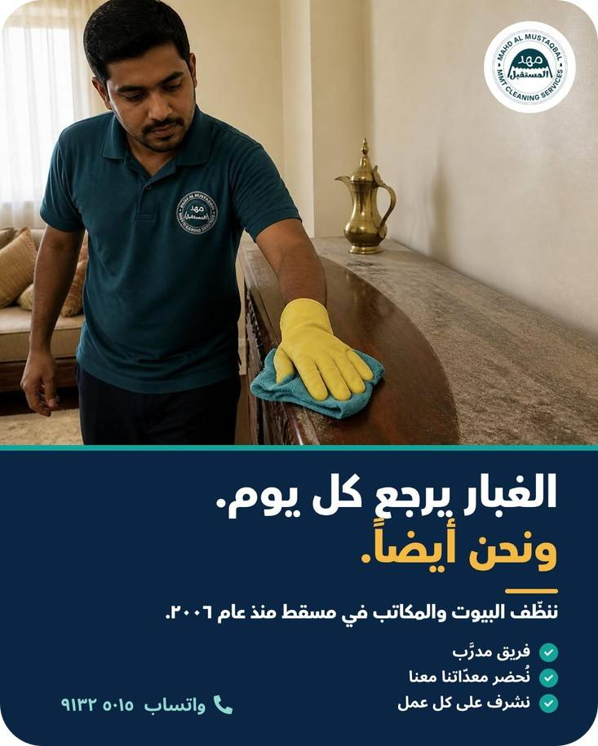
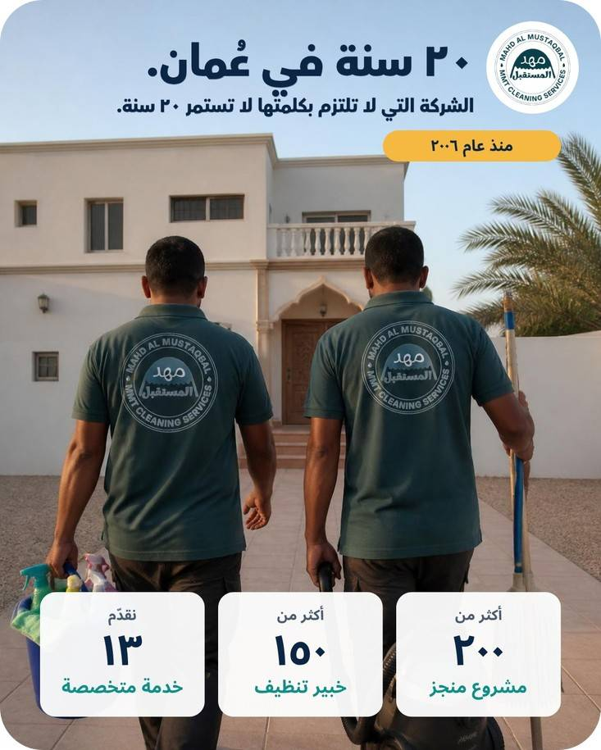
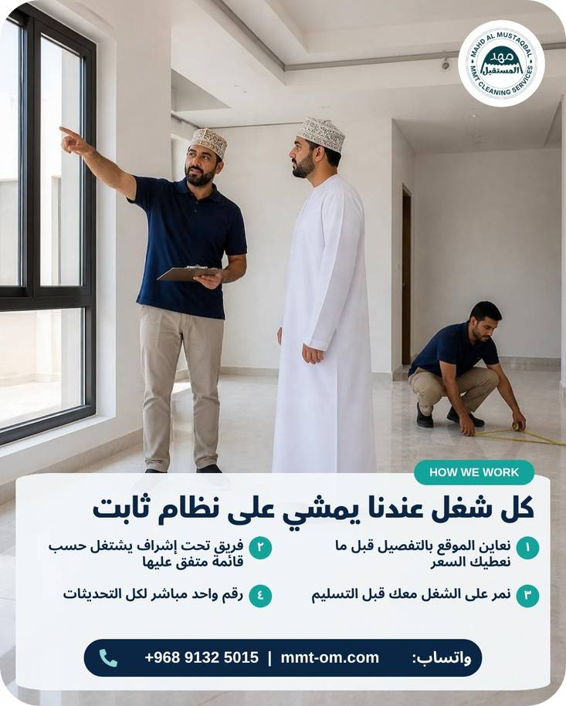
GALLERY · CONTINUED
Every detail, every visit
Notes:
MMT social media posts gallery.

Slide 28
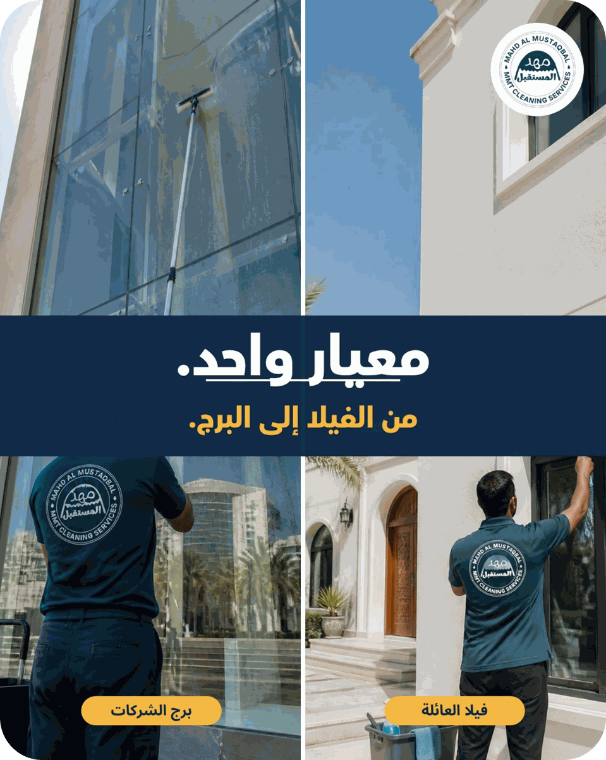




FOLLOW OUR WORK
See MMT in action every week
Real teams, real homes and real buildings across Oman. Follow us for tips, projects and behind-the-scenes from our crews.
Instagram
@mmtoman0
Facebook
@mmtoman0
TikTok
@mmtoman0
Website
www.mmt-om.com

Slide 29

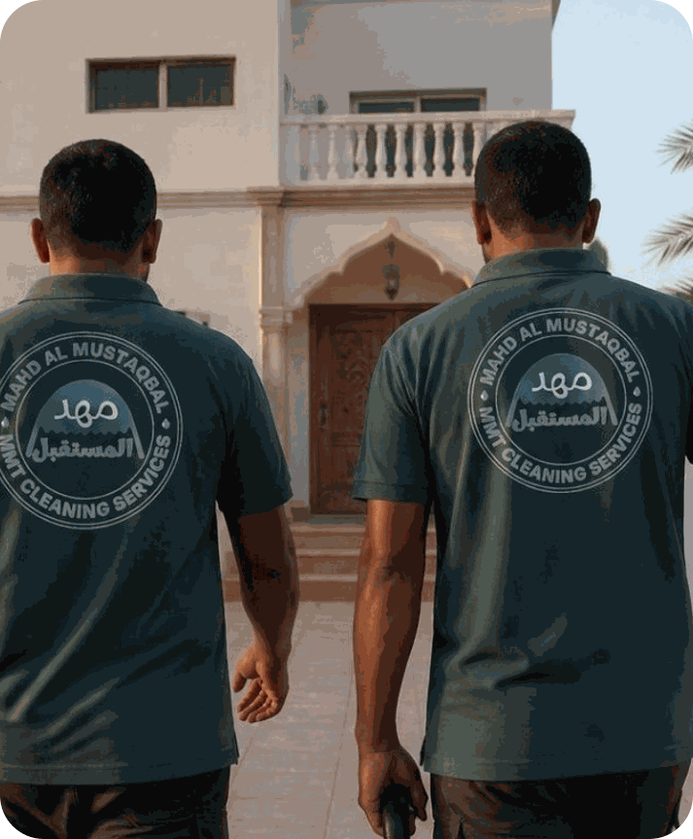


LET'S WORK TOGETHER
Thank you
Clean spaces. Healthy living. Better business.
Business Tower, Muscat Hills, Muscat, Oman
+968 9132 5015 · +968 9970 9696
info@mmt-om.com
www.mmt-om.com
@mmtoman0 · Facebook · Instagram · TikTok

